Slide 1

BLOCKCHAIN TECHNOLOGY

Slide 2
BLOCKCHAIN TECHNOLOGY
Course Code | : | 22MCA333 |  | CIE Marks | : | 50
Teaching Hours /Week (L:T:P:S) | : | 3-0-0-0 |  | SEE Marks | : | 50
Total Hours | : | 39 |  | Credits | : | 03

Slide 3
UNIT– I
Introduction to Blockchain
How Blockchain Works
Blockchain VS Bitcoin
Practical Application
Public and Private Key Basics
Pros and Cons of Blockchain
Myths about Bitcoin

Slide 4

Why I Should Study Blockchain
It is a Disruptive Technology

Slide 5
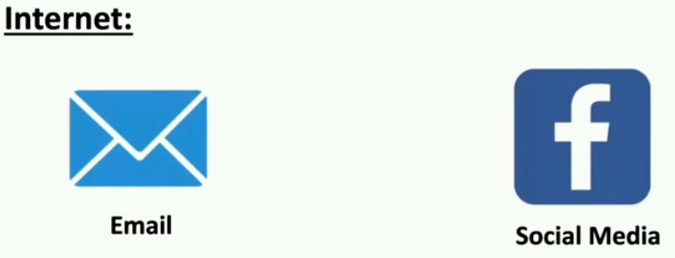
Why I Should Study Blockchain

Slide 6
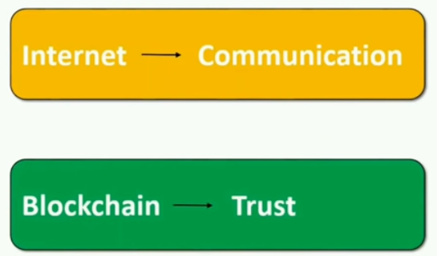
Why I Should Study Blockchain
Satoshi Nakamoto (invented bitcoin-2008 after financial crisis)

Slide 7


Why I Should Study Blockchain
It is a Disruptive Technology
Can we trust?

Slide 8
Blockchain is the backbone Technology of Digital Cryptocurrency BitCoin.
The blockchain is a distributed database of records of all transactions or digital event that have been executed and shared among participating parties.
Each transaction verified by the majority of participants of the system.
It contains every single record of each transaction.
BitCoin is the most popular cryptocurrency an example of the blockchain.
Blockchain Technology first came to light when a person or Group of individuals name ‘Satoshi Nakamoto’ published a white paper on “BitCoin: A peer to peer electronic cash system” in 2008.
Blockchain Technology Records Transaction in Digital Ledger which is distributed over the Network thus making it incorruptible.

Slide 9
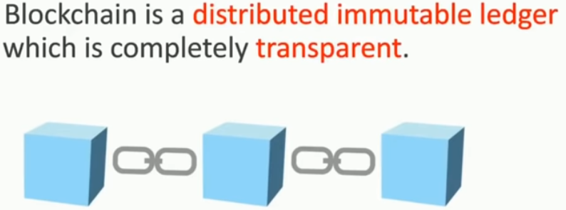
What is Blockchain

Slide 10
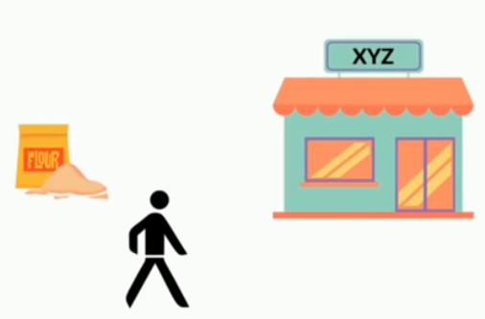
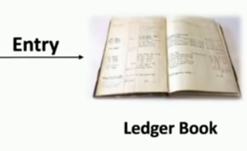

What is Blockchain

Slide 11
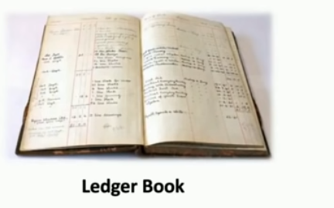
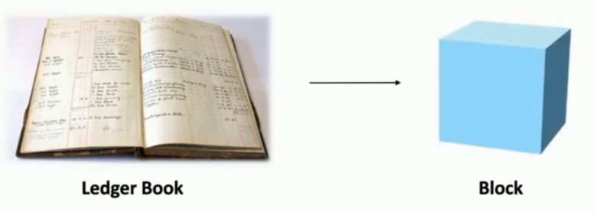
What is Blockchain

Slide 12
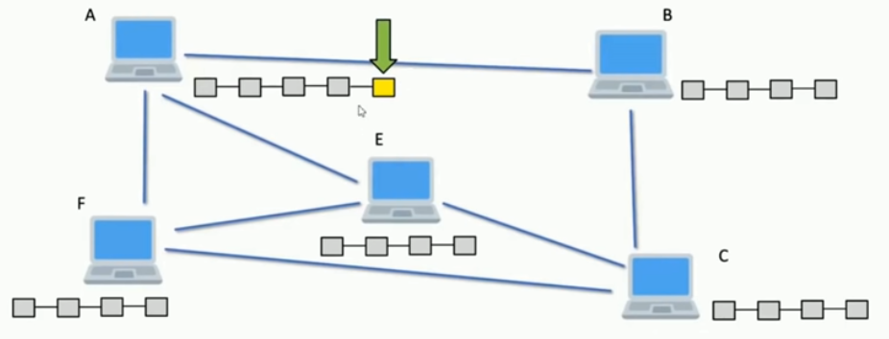
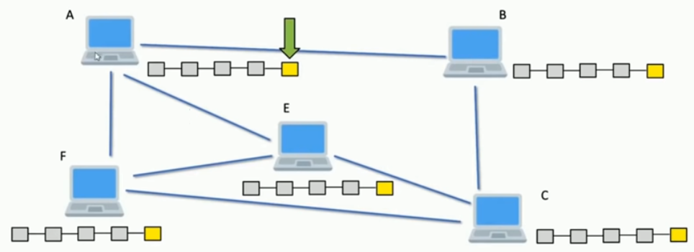
What is Blockchain

Slide 13
WHAT IS BLOCKCHAIN?
A Linked List
Replicated
Distributed
Consistency maintained by Consensus
Cryptographically linked
Cryptographically assured integrity of data
Used as
Immutable Ledger of events, transactions or time stamped data
Tamper resistant log
Platform to Create and Transact in Cryptocurrency
log of events/transactions unrelated to currency

Slide 14
LET’S FIRST TALK ABOUT BANKING

Slide 15
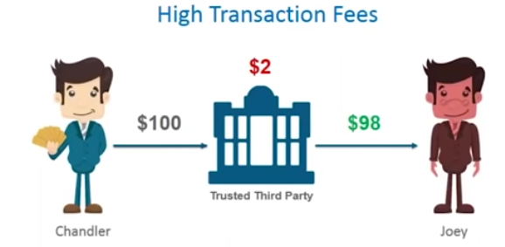
LET’S FIRST TALK ABOUT BANKING-ISSUES

Slide 16
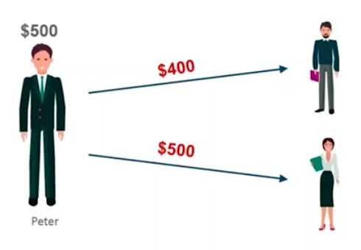

LET’S FIRST TALK ABOUT BANKING-ISSUES
Double Spending - Simultaneously

Slide 17
HOW DO YOU TRANSACT?
Your write a check or do internet transaction to pay a payee
Bank checks if you have balance > transaction amount
If yes, it debits your account by balance = balance ‐ transaction_amount
credit’s payee’s account by payee.balance = payee.balance + transaction_amount
If no, the transaction is invalid and rejected.
You can check your transaction list online, or check the monthly statement
Who maintains the ledger?
Bank Does
What if Bank allows an invalid transaction go through
Invalid = you did not authenticate the transaction
Invalid = your balance was not sufficient but transaction was made

Slide 18
Bank Frauds
You find a check was used to pay someone but you never wrote the check
Someone forged your check and/or signature
You did sign a check for x amount, but the amount field was modified
How do you prove to the bank that an extra 0 was not there in your signing time?
The monthly statement says that you did a transaction but you did not recall or the amount of a transaction is different from what you had done
Someone got your password, and possibly redirected OTP to another SIM (SIM Fraud)
Bank employees themselves might have done something
How do you argue to the bank? (Non-repudiation)
How do you argue that the amount was modified? (Integrity)
Finally, do you tally your transactions when you receive your monthly statement?
Most people do not

Slide 22

Again, What is a Blockchain? –who invented?
Proposed in their research paper published in 1991, entitled, “How to digitally time stamp a document”

Slide 23
Again, What is a Blockchain?
Blockchain technology is a digital innovation that has the potential to significantly impact trusted computing activities and therefore cybersecurity concerns as a whole.
Attractive properties of Blockchain
Log of data with digital signature
Immutable (once written - cryptographically hard to remove from the log)
Cryptographically secure - privacy preserving
Provides a basis for trusted computing on top of which applications can be built

Slide 24
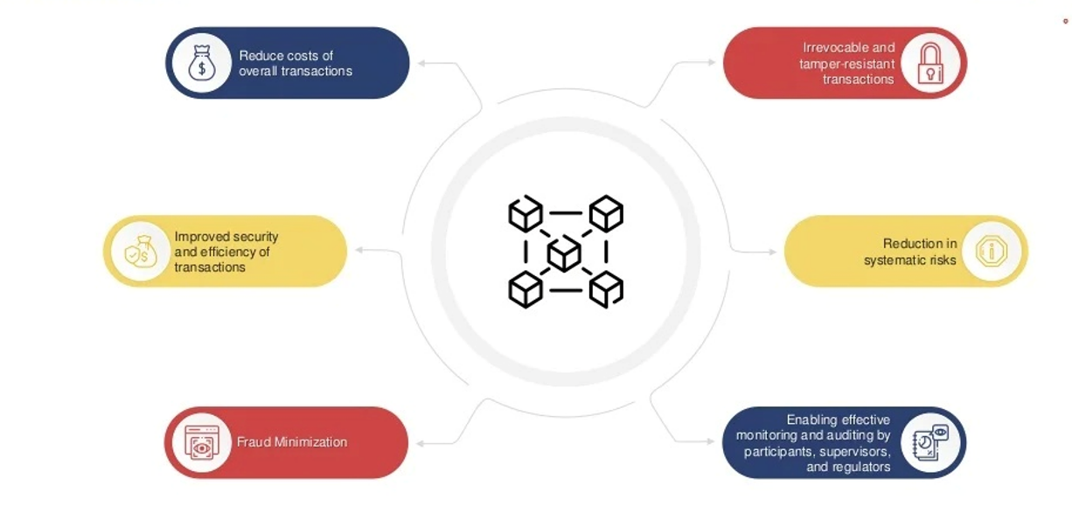
How Blockchain Transforming Business

Slide 25
How Does the Blockchain Work?
A blockchain is a distributed database that stores information electronically in a digital format and is shared among the nodes of a computer network. A typical difference between a blockchain and a database is how data is structured. A blockchain is a shared, immutable ledger as the name suggests structures data into chunks or blocks, and a database structures data into tables. A blockchain is a chain of blocks. Once a block is filled with data and it is chained to the previous blocks. Different types of information can be stored on the blockchain network but the most important is transactions.
The transaction process in a blockchain can be summarized as follows:
1. Facilitating a transaction: A new transaction enters the blockchain network. All the information that needs to be transmitted is doubly encrypted using public and private keys.
2. Verification of transaction: The transaction is then transmitted to the network of peer-to-peer computers distributed across the world. All the nodes on the network will check for the validity of the transaction like if a sufficient balance is available for carrying out the transaction.
3. Formation of a new block: In a typical blockchain network there are many nodes and many transactions get verified at a time. Once the transaction is verified and declared a legitimate transaction, it will be added to the mem pool. All the verified transactions at a particular node form a mem pool and such multiple mem pools form a block.
4. Consensus Algorithm: The nodes that form a block will try to add the block to the blockchain network to make it permanent. But if every node is allowed to add blocks in this manner then it will disrupt the working of the blockchain network. To solve this problem, the nodes use a consensus mechanism to ensure that every new block that is added to the Blockchain is the one and only version of the truth that is agreed upon by all the nodes in the Blockchain, and only a valid block is securely attached to the blockchain.

Slide 26
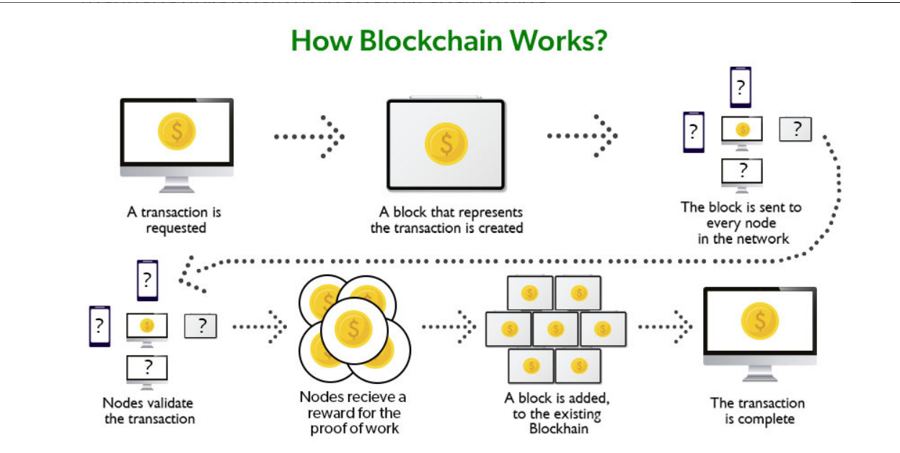
The node that is selected to add a block to the blockchain will get a reward and hence we call them “miners”. The consensus algorithm creates a hash code for that block which is required to add the block to the blockchain
5. Addition of the new block to the blockchain: After the newly created block has got its hash value and is authenticated, now it is ready to be added to the blockchain. In every block, there is a hash value of the previous block and that is how the blocks are cryptographically linked to each other to form a blockchain. A new block gets added to the open end of the blockchain.
6. Transaction complete: As soon as the block is added to the blockchain the transaction is completed and the details of this transaction are permanently stored in the blockchain. Anyone can fetch the details of the transaction and confirm the transaction.

Slide 27
Let’s understand this working of blockchain with the help of an example:
Let’s say Jack and Phil are two nodes on the bitcoin blockchain network who wants to carry out a transaction between them.
Step 1: Facilitating the transaction: Jack wants to send 20 BTC to Phil via the Blockchain network.
Step 2: Verification of transaction: The message for verification will be sent to all the nodes on the network. All the nodes will check the important parameters related to the transaction like Does Jack has sufficient balance i.e. at least 20BTC to perform the transaction. Is Jack a registered node? Is Phil a registered node? After checking the parameters the transaction is verified.
Step 3: Formation of a new block: A number of verified transactions stack up in mem pools and get stored in a block. This verified transaction will also get stored in a block.
Step 4: Consensus algorithm: Since here we are talking about bitcoins so the Proof-of-Work consensus algorithm will be used for block verification. In proof-of-work, the system assigns the target hash value to a node, and according to this, it must come up with a hash for the new block. The node has to calculate the hash value for the new block that is less than the target value. If two or more miners mine the same block at the same time, the block with more difficulty is selected. The others are known as stale blocks. Mining usually rewards miners with blockchain currency. In this case, the blockchain currency is bitcoin.
Step 5: Addition of the new block in the blockchain: After the newly created block has got the hash value and authentication through proof-of-work only then it will be added to the network and the transaction will mark as complete. Phil will receive 20 BTC from jack. The new block will be linked to the open end of the blockchain.

Slide 28
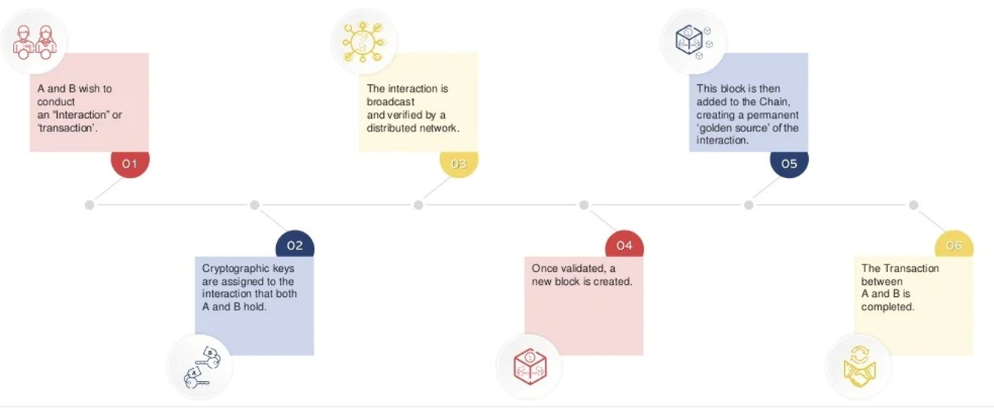
Step 6: Transaction complete: As soon as the block is added to the blockchain, the transaction will take place and 20 BTCs will get transferred from Jack’s wallet to Phil’s wallet. The details of the transaction are permanently secured on the blockchain.
Anyone on the network can fetch the information and confirm the transaction. This will help to keep track of all the transactions and to verify whether any user is trying to double spend. For example, if Jack tries to carry out a transaction in the future, the rest of the nodes can check Jack’s past transaction records to check whether Jack has enough balance to carry out the current transaction. If there is enough balance then the transaction will be approved.

Slide 29
Myths About Bitcoin
1.Bitcoin Is Dead
The most common myth that people repeat about Bitcoin is that it is dead and no longer used by anyone in the world. There is a website, Bitcoin Obituaries, which keeps track of the declarations of Bitcoin’s death going all the way back to 2010. At that time, bitcoin was trading at $0.23.
In reality, Bitcoin is currently at its most successful point in history -- at least when measured by the number of transactions that are happening on the network every day. The real problem right now is scalability (increasing block size to handle more transactions), which Blockchain Capital Managing Partner Brock Pierce recently pointed out is a sign of its success.
2.Bitcoin Is Anonymous
Although Bitcoin is often referred to as the “anonymous currency of the dark web,” it is more correct to say that Bitcoin addresses are pseudonymous. This means that there is an identifiable address (or many addresses) for each user on the network, but no one necessarily knows who is behind each address.
With Bitcoin, it’s important to remember that every transaction is recorded on a completely public ledger that anyone can view on a block explorer. A few blockchain analytics companies have popped up over the past few years, and they’re able to deanonymize large portions of the network.

Slide 30
3. Bitcoin Is Completely Transparent
It’s also a myth that Bitcoin is completely transparent. As mentioned in the above section, the true identities of the individuals or organizations behind specific Bitcoin addresses are not always known. There are also various privacy-enhancing services, such as JoinMarket, which allow users to enhance their privacy on the blockchain. There are also other enhancements, such as Confidential Transactions and Zerocash, that could come to Bitcoin in due time.
Rather than being completely anonymous or completely transparent, Bitcoin is better identified as somewhere between these two extremes.
4. Bitcoin Is Used by Terrorists
Whenever Bitcoin is brought up in a movie or television show, it’s almost always being used by some kind of serious criminal or terrorist; however there is no evidence of terrorists using Bitcoin on any noteworthy scale. In fact, a Europol investigation from earlier in the year found, “Despite third-party reporting suggesting the use of anonymous currencies like Bitcoin by terrorists to finance their activities, this has not been confirmed by law enforcement.”
Although Bitcoin is sometimes used for illegal transactions on the Internet, the reality is that the privacy issues related to the public blockchain make it a poor choice for terrorists. In the world of untraceable payments, cash is still king.The Winklevoss Twins, who founded a Bitcoin exchange called Gemini, have gone as far as to say Bitcoin is a haven for really stupid criminals.

Slide 31
5. Bitcoin Is Not Backed By Anything, So It Has No Value
Many gold bugs and those who do not understand the value of a decentralized, censorship-resistant digital payment network believe bitcoins are essentially worthless because they aren’t backed by anything. There are varying opinions on this point. Some believe bitcoin’s scarcity is the main attribute that gives it value, while others claim bitcoins are useful because they are required to use the world’s most prominent and secure decentralized ledger.
Currency Wars author and gold bull Jim Rickards recently took issue with the argument that bitcoins are backed by nothing, pointing out that like all currency in the history of money, bitcoins are backed by confidence. (Also known as consensus.) Gold is valuable because people agree that it is.
6. Bitcoin’s Price Volatility Makes It Useless
While Bitcoin has had quite a volatile history, the trend has definitely been toward stability since the first blocks were mined in early 2009. Having said that, not many people are attempting to use bitcoin as a unit of account right now. Instead, the digital currency, commodity or however you want to define it is mainly viewed as a store of value by those who hold it.
There are also various mechanisms for using the Bitcoin network for payments while avoiding the volatility associated with the token of value. Some Bitcoin companies, such as Circle and Coinbase, allow users to store funds in U.S. dollars or other fiat currencies before making Bitcoin transactions on the user’s behalf.

Slide 32
7. Bitcoin Is Only Used for Illegitimate Purposes
One of the fundamental values of Bitcoin is its resistance to censorship. As Elon Musk put it in 2014
“I think it’s primarily going to be a means of doing illegal transactions. But that’s not necessarily entirely bad. You know, some things maybe shouldn’t be illegal.”
What is or isn’t a legitimate or legal transaction can change when moving between various jurisdictions, but Bitcoin is also used for completely legal purposes. Some people use Bitcoin to save 10-20 percent on purchases at Amazon, Starbucks and Target via Foldapp and Purse.io. Others see it as a valuable tool for cheaper international money transfers and remittances. Abra, Align Commerce and Freemit are three startups using Bitcoin to lower the costs of money transfers around the world.
8. Bitcoin Mining Wastes Electricity
A recent report found that Bitcoin’s network hashrate could consume as much power as Denmark by 2020. Other reporters dispute this characterization, pointing out that Bitcoin uses the same electricity as the yearly consumption of 674.5 average American homes, two Amtrak locomotives or a California hydroelectric plant. Do these things waste electricity? It depends on your point of view. The reality is that the use of computing power serves a purpose in Bitcoin, which is securing all of the transactions on the network. If you don’t think Bitcoin is valuable, maybe that’s a waste. If you don’t think fiat currencies are valuable, maybe keeping the lights on at the Federal Reserve is a waste.
Electricity-intensive Bitcoin mining is essentially a way to prove that someone has expended resources in hopes of getting a block reward and transaction fees in return for their efforts. Proof-of-work, as it’s called, acts as a prevention mechanism against Sybil attacks (forged identities) on the Bitcoin network. Waste? You decide.

Slide 33
Blockchain Vs Bitcoin
The basis for comparison between Bitcoin vs Blockchain | Bitcoin | Blockchain
What is it? | A crypto-currency | A ledger
Main Aim | To simplify and increase the speed of transactions without much of government restrictions. | To provide a low cost, safe, and secure environment for peer-to-peer transactions.
Trade | Bitcoin is limited to trading as a currency. | Blockchain can easily transfer anything from currencies to property rights of stocks.
Scope | The scope of bitcoin is limited. | The blockchain is more open to changes and hence has the backing of many top companies.

Slide 34
Blockchain Vs Bitcoin
Strategy | Bitcoin focuses on lowering the cost of influencers and reduces the time of transactions but is less flexible. | Blockchain can be adapted to any change and hence it can cater to different industries.
Status | Bitcoin likes to be anonymous and hence even though we can see the transactions in the ledger, they are numbers that are not in any particular sequence. | As blockchain works with various businesses, it should have compliance with KYC and other norms. Hence blockchain is very transparent.

Slide 35
Whenever we talk about bitcoin and blockchain, people generally think they are the same because bitcoin was the first-ever blockchain application. People usually mistake bitcoin vs. blockchain.
Since then, blockchain has undergone huge technological changes, and now blockchain is even catering to other industries.
Bitcoin is a digital currency that can also be called as a top cryptocurrency. It was mainly created to speed up cross-border transactions, reduce the government’s control over the transaction, and simplify the whole process without having third-party intermediaries.
Bitcoin is not a formally accepted medium of payment, but people worldwide use it for various kinds of transactions. Since it is not physically present, it is safe and secure, and blockchain is the best way to do these transactions.
The blockchain is a type of ledger that records all the transactions and helps in peer-to-peer transactions. It is open, secure, and easily accessible to all.
Blockchain thus acts as bitcoin’s ledger and takes care of all Bitcoin transactions. Since then, blockchain has grown from strength to strength, and now it is catering to even small transactions across various industries.
Blockchain has made the technology adapt to different areas and industries such that the technology can be changed according to the high-quality standard that each company requires.
Here are the key difference between Bitcoin and Blockchain–
One of the key differences between bitcoin and blockchain is adaptability. When we look at bitcoin, we look at something that is rigid and concentrates on cross-border transactions. While blockchain first started as a ledger of the bitcoin currency, it began to improve and slowly started catering to other industries. It has made continuous improvements in technology, and now blockchain is the hottest thing running in the market.

Slide 36
The blockchain is a distributed ledger that enables peer-to-peer transactions in one of the safest environments. Transactions done through blockchain are made public so that they can be transparent. Bitcoin is a cryptocurrency used to reduce the transaction charges and transaction time of cross-border transactions.
Bitcoin is a little bit of a closed system, and it very much likes anonymity. Even when we find the transactions in the ledger, bitcoin vs. blockchain are recorded in numeric codes that people can’t understand, which is why it is unable to move forward. On the other hand, blockchain has been working with various industries, and hence it should comply with the rules and norms of the companies like anti-money laundering, knowing your customer, etc. So, it shows all the transactions clearly, and the public has full access to the ledger; thus, companies trust more on the blockchain.

Slide 37
Applications and Uses of Blockchain
Cryptocurrencies: A cryptocurrency is a digital currency, basically designed to be used as a medium of exchange wherein each coin ownership record is stored in a decentralized ledger. Cryptocurrencies use ‘decentralized control’, which suggests that they are not controlled by one person or government. When Bitcoin launched in 2008, it allowed people to directly transact with each other without having to trust third parties like banks. Since then 4000 different cryptocurrencies have been created. Some examples are Bitcoin, Ethereum, Dogecoin, Fantom, etc. The blockchain is the technology behind cryptos where all the exchange or transaction information is stored which cannot be hacked or changed and a copy of the ledger is distributed among all the participants of the network. It records every single transaction. Each and every person can buy/sell or deal in cryptos and be a part of the network. Nowadays, several financial applications provide a user with the luxury of doing so.
Cars: Let us see how can blockchain be used in cars. Ever heard of odometer fraud? By tampering with the odometer, someone can make a car appear to be newer and less worn out, resulting in customers paying more than what the car is actually worth. The government tries to encounter by collecting the mileage of cars when they get a safety inspection, but that’s not enough. So, instead, we could replace regular odometers with smart ones that are connected to the internet and frequently write the car’s mileage to the blockchain. This would create a secure and digital certificate for every car. And because we use a blockchain, nobody can tamper with the data/information, and everyone can look up a vehicle’s history to ensure it’s correct. In fact, this has already been developed used by Bosch’s IoT lab and they are currently testing it on a fleet of 100 cars in Germany and Switzerland.

Slide 38
Legal Documents: So, blockchains are great at keeping a good track of data over time. So, besides odometers, you can keep track of things like intellectual property or patents or it can even function as a notary. A notary is someone (for example the Central Government) who can confirm and verify signatures on legal documents. But we can just as well use blockchain for it. The online website stampd.io as an example, allows you to feature the documents to the Bitcoin or Ethereum Blockchain. Once, a document has been added you can always prove that you simply created a document at a particular point of time very similar to a notary, although right now blockchains are not on the same level as notaries in a legal perspective.
Digital Voting: Another interesting application is digital voting. Right now voting happens either on paper or EVM (electronic voting machines) which are special computers running proprietary software. Voting on paper costs a lot of money and wastage and electronic voting has security issues. In recent years we have seen countries move away from digital voting and adopting paper again because they fear that electronic votes can be tampered with and influenced by hackers. In our country as well, we have seen politicians fight over “EVM hack” things. But, in place of paper ballots or EVMs, we could use blockchains to cast and store votes. Such a system would be very transparent and everyone could verify the voting count for themselves and it would make tampering with it very difficult. The Swiss company Agora is already working on such a system and it is going to be completely open-source. But there are many challenges. First, you have to be able to verify voters without compromising their privacy. Secondly, if you allow people to vote with their own computers or phones, you have to take care of the situation that those devices might be infected with malware designed to tamper with the voting process. And a final example: a system like this also has to be able to withstand denial-of-service attacks that could render the whole thing unusable. Definitely, a very tough nut to crack but if it becomes reality it could make for a more transparent and practical voting system.

Slide 39
Food and Medical Industry: They could use blockchain technology to track their food products from the moment they are harvested or made, to when they end up in the hands of the customers. See, every year almost half a million people die because of food-borne diseases and that’s partly because it takes too long to isolate the food that is causing harm. Blockchains could help us to create a digital certificate for each package of food, proving where it came from and where it has been. So, if contamination has been detected i.e. the manufacturer wants to revert a batch of food because of certain quality issues, we can trace it back to its root and instantly notify other people who bought the same batch of bad food. Walmart and IBM are the two big giants currently working on such a system. It allowed them to trace the origin of a box of mangoes in just 2 seconds, compared to days or even weeks with a traditional system. A system like this could be applied to other similar industries as well. We could use it to track medicines, and other regular products and battle counterfeit goods by allowing anyone (the officials in general) to verify whether or not the product comes from the original and authentic manufacturer.
Logistics and Supply-chain: Another idea would be to track packages and shipments using blockchain. That is something that IBM and container shipping giant Maersk Line are working on a decentralized ledger to help with making the global trade of goods more efficient. Many hackathons on blockchain have this topic for college students to build the project. It is still in the development phase and companies are trying to come up with such a system to track their package pinpoint.
Smart Contracts: So far, we have looked at ways blockchains can be used to keep track of information and verify its integrity. But blockchains are even more powerful when we use them as smart contracts as one of its applications. These contracts live on the blockchain and can perform actions when various conditions are met. Insurance companies could use smart contracts to validate claims and keep a record of all the people who are buying insurance and paying their premiums on time so as to continue the terms of the policy. Or they could allow us to only pay for car insurance when we are driving. But it goes even further, with smart contracts we can our own data on a blockchain. In the same fashion, you could store your personal identity there and choose what data you want to reveal.

Slide 40
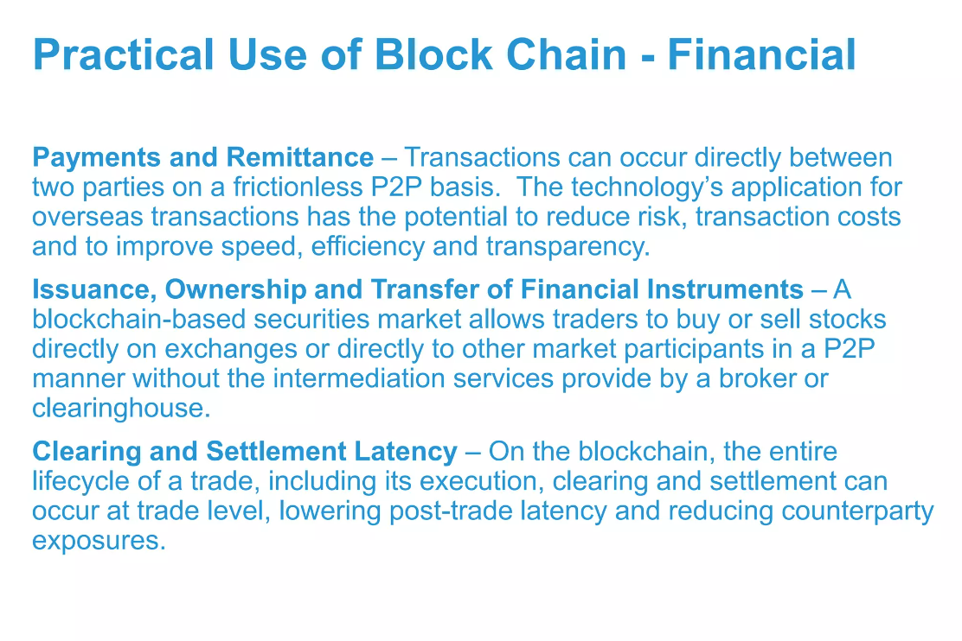

Slide 41
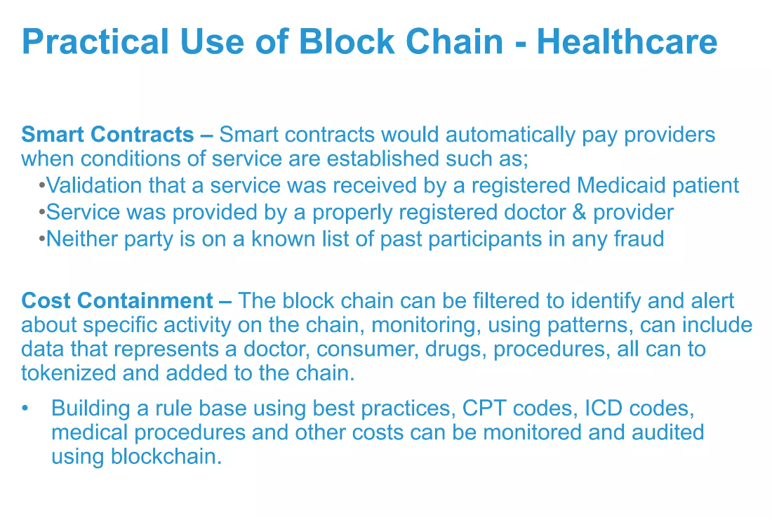

Slide 42
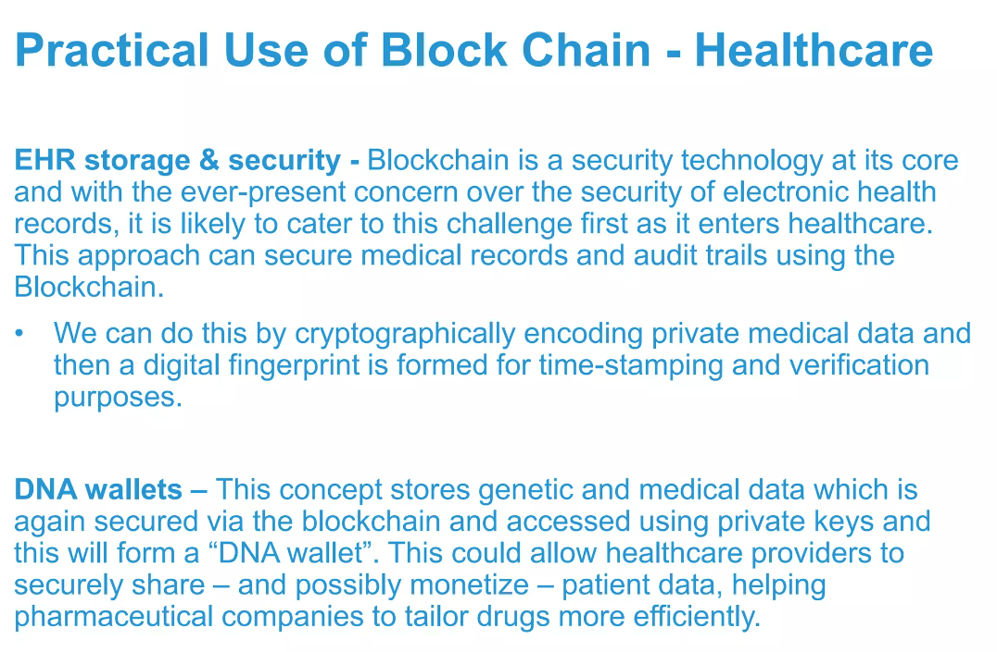

Slide 43
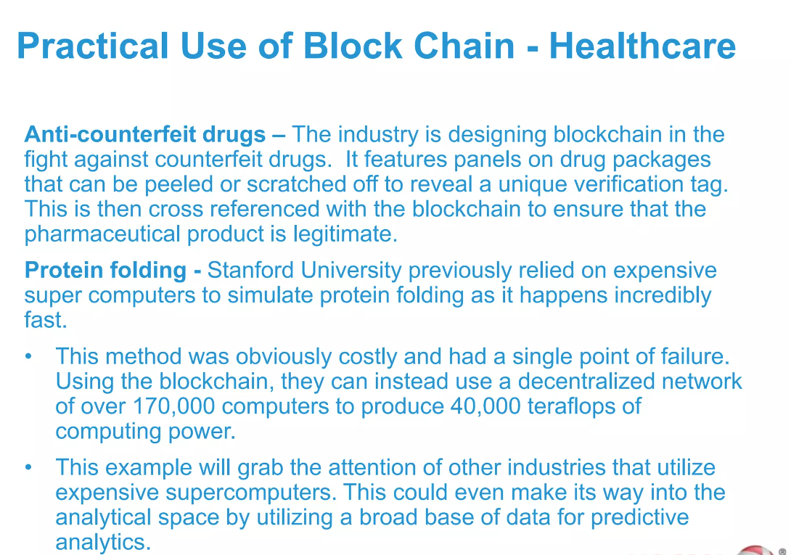

Slide 44
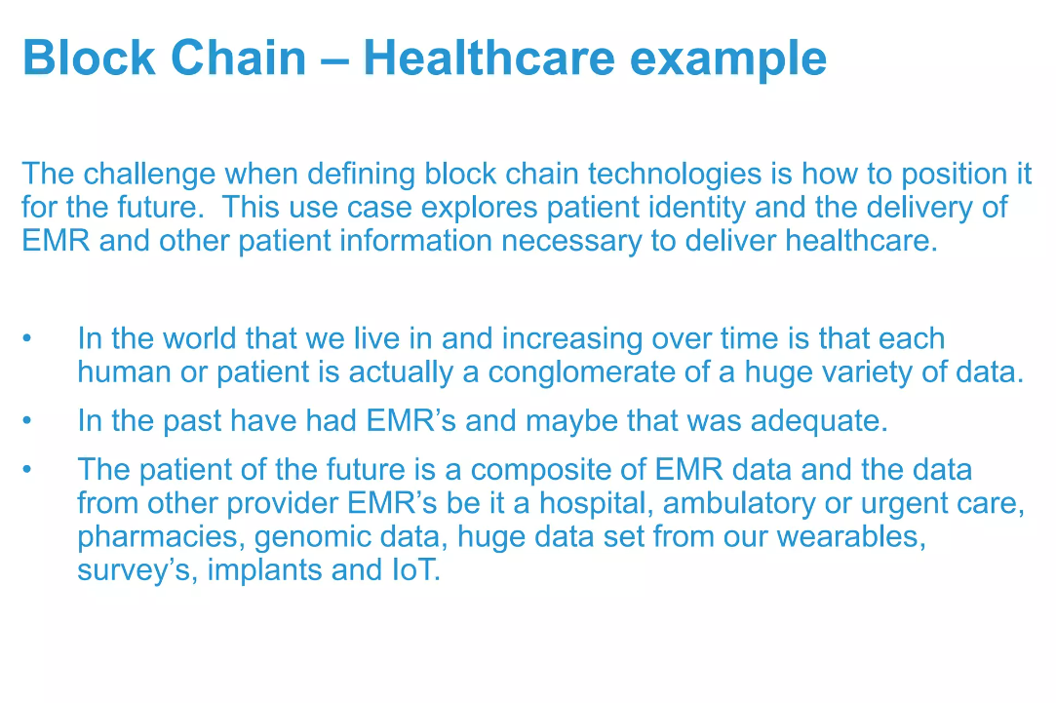

Slide 45
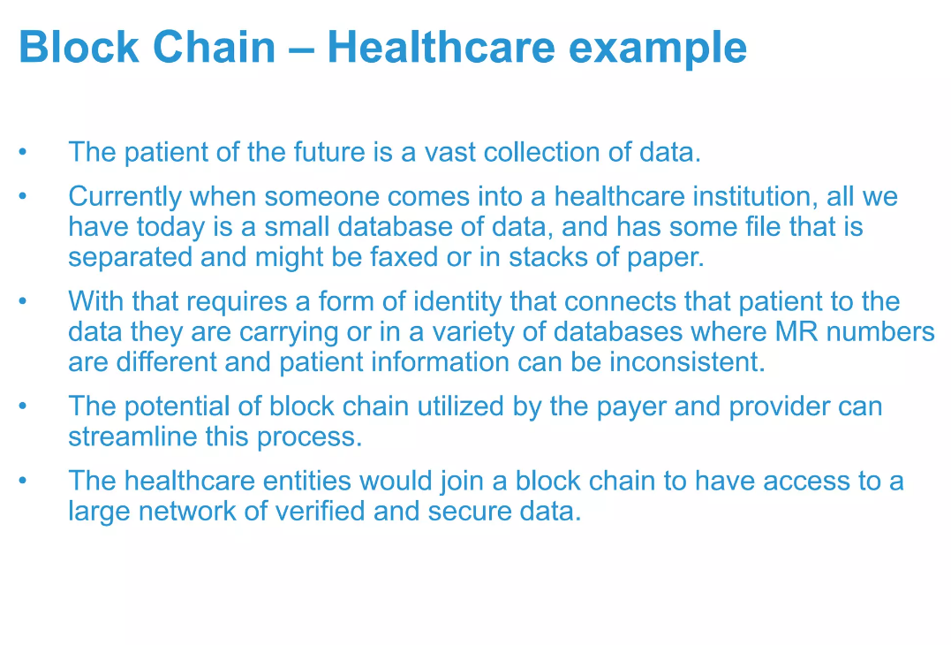

Slide 46
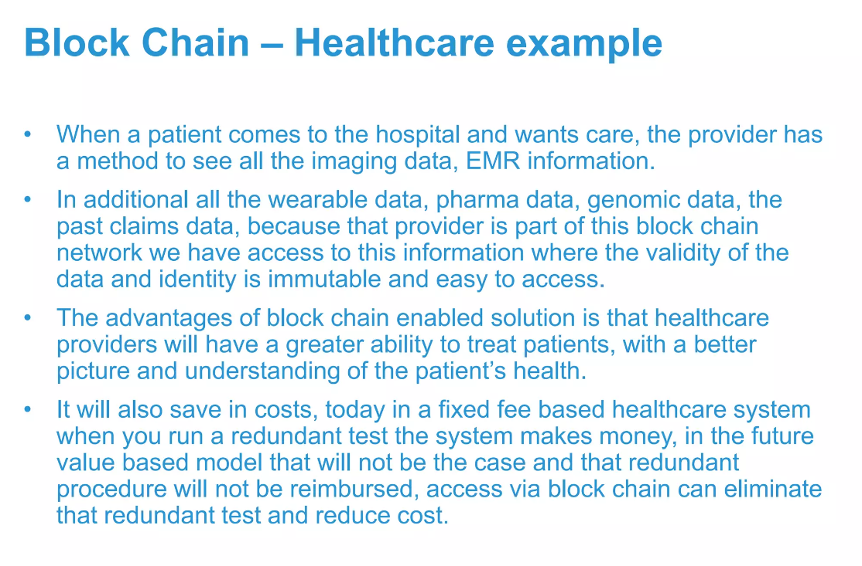

Slide 47
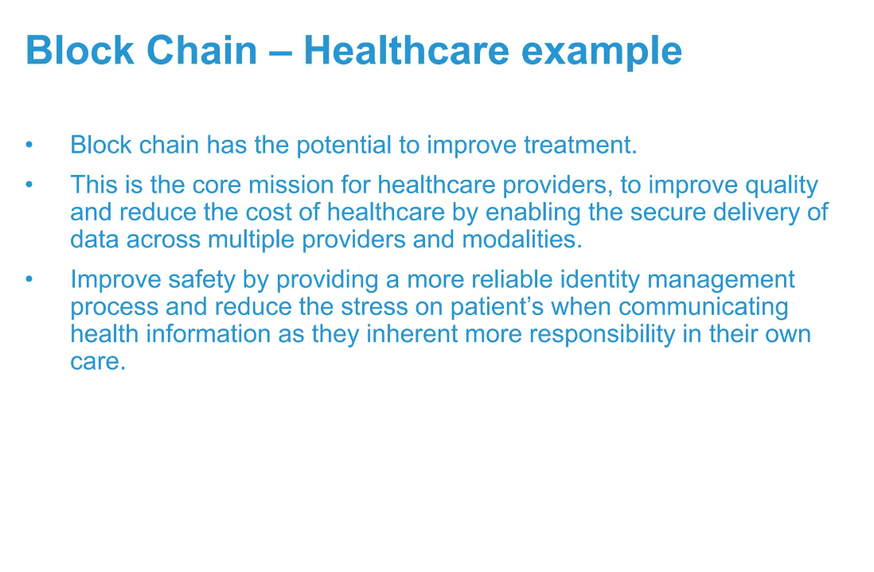

Slide 48
Major Pros of Blockchain Technology
1) Decentralized Trust
2) Low Operational Cost
3) No Single Point of Failure
4) Enhanced Security And Confidentiality
5) Quick Transactions
6) Reduces Fraud
7) Transparent & Universal Recording System
8) Better Accessibility
9) Prevents Double Spending
10) Seamless Integration Into Existing Systems

Slide 49
Decentralized Trust
One of its biggest strengths is that you no longer need to trust a third party to make any transaction. People using blockchain worldwide are confident that no single party is manipulating transactions, viewing personal information or performing any other activity breaching their privacy and security.
That doesn’t mean blockchain-based applications are always secure—that depends on how good developers are at creating secure code—but it does mean there are opportunities for better security than conventional applications. With blockchain, you can feel more confident about your data and identity.
Low Operational Cost
Blockchain reduces overhead costs as it has no centralized authority or servers to maintain operations. There are no payment processing or banking fees as it opts for peer-to-peer transactions without third-party approval. It embeds documents, agreements, or transactions within the system.
No Single Point of Failure
With blockchain technology, there’s no single point of failure. If a hacker were to gain access to your business’s server or database, they could very easily wipe out your entire network—all at once.
Blockchain technology is not centralized; instead, it is in distributed form. It saves your data if the network goes down as hackers cannot break into the central grid and affect any connected account.
You can create passwords up to 100 characters long, making it impossible for hackers to guess or decode. It gives better security than regular networks with the option of up to 8-character long passwords (including letters and numbers)

Slide 50
Enhanced Security And Confidentiality
Being distributed across a global network of computers and protected by cryptography, blockchain technology is inherently more secure than centralized systems.
As the Economist reports, it is tough to tamper with records once they are in there. Any attempt to alter one’s record will reflect immediately because copies and digital signatures are checked against each other automatically.
It has an added layer of confidentiality that secures your data from hackers. Transactions are impossible to trace or link back to an individual user. The user can select their names and e-mail addresses during transactions. You get the option to complete your transactions while remaining anonymous.
Quick Transactions
Blockchain is capable of processing much faster transactions than any traditional bank. As a result, businesses that use blockchain instead of banks can save a considerable amount on fees.
Deloitte has predicted that blockchain technology could save companies up to billions in the form of banking fees. Blockchain’s decentralized structure doesn’t require massive data centers and expensive third-party verification. It also limits the number of people involved in monitoring the transactions.
Reduces Fraud
Blockchain technology has some fantastic attributes that make it ideal for financial institutions to reduce forgery. It records every activity, making it impossible for anyone to make duplicate transactions.
Each block stores the financial information, and if any modification is made to a previous block, other nodes on the network rejected it.
Once your bank confirms your transaction, they can’t deny receiving the funds. On top of that, you could see that fraudulent activity happened when another node changed transactions.

Slide 51
Transparent & Universal Recording System
The transactions in the blockchain are recorded in a public ledger that anyone can view. All can see the amount stored in the wallet but cannot identify its owner.
A wallet could be tied to an individual or group. Still, if users want to remain anonymous, they must transfer their Bitcoins to another address (e.g., a different Bitcoin wallet) that isn’t linked with their real identity.
But even without anonymity features enabled, blockchain tech provides more transparency than traditional payment methods like credit cards and checks; you don’t need a bank intermediary (or permission from one) to see what or whom you paid or received money from.
Better Accessibility
A blockchain allows anyone with a computer and an internet connection to be part of its network. It is decentralized, meaning any single entity can’t control it—and everyone has equal access to it.
Anyone can make changes (add information) or add new blocks (to store data) to a blockchain, provided they know how to do so. Even non-tech individuals have the same access to blockchains! This openness makes blockchains much more accessible than traditional institutions like banks and financial services.
That doesn’t mean you shouldn’t be wary when dealing with blockchain providers: you should always research your choices before making any significant financial decisions.

Slide 52
Prevents Double Spending
Bitcoin transactions are verified by network nodes through cryptography and recorded in a publicly distributed ledger called a blockchain. This ensures safety by eliminating direct access to your money.
That’s why some say bitcoin is fungible—its value is equal even if its physical form changes. In other words, bitcoins derive their worth from mathematics alone, unlike fiat currencies like U.S. dollars or euros, which get their value from an organization’s financial standing.
Seamless Integration Into Existing Systems
Blockchain offers seamless integration of their current financial systems into the outside networks. It can be done in two ways: Blockchain as a Service (BaaS) and blockchain application platforms.
BaaS offers organizations a secure connection to blockchain networks using cloud services, while blockchain application platforms allow anyone – even those without cloud services – to use blockchain technology. The integration process is much more seamless than other means of blockchain access.
Blockchain as a Service allows businesses to connect directly with blockchain networks, giving them immediate access to these decentralized ledgers. It doesn’t force you to use one blockchain or another and gives you a higher level of control than some other methods.

Slide 53
Major Cons of Blockchain Technology
1) Scalability
Blockchain is capable of handling fewer transactions per second. It causes delays in finalizing the massive volume of transactions resulting in poor scalability. However, several methods have been proposed to overcome this shortcoming, but none has been implemented till now.
2) Security
Blockchain is publicly accessible as a distributed ledger. It may attract any unknown visitor monitoring your wallet. Though there are several provisions to add privacy and encryption layers to enable your preferred privacy, all are not commonplace yet.
Moreover, much of your data is linked directly to your digital identity, so it could potentially expose parts of your private life that you wouldn’t necessarily want online. Security concerns often lead people to trust third-party solutions (like exchanges) over direct blockchain transactions, relinquishing control over personal assets.
3) Cost
One of the biggest problems with blockchain technology is that it requires enormous energy. Because miners have to solve complicated math problems to get a payout, they need powerful rigs that consume tons of electricity.
As a result, some blockchains are incredibly costly to run, especially for smaller businesses or individuals. You cannot make changes later; if you want your blockchain online, you must pay for it up front!

Slide 54
4) Competitiveness
There is a lot of hype surrounding these industries trying to use blockchain. It leads to unnecessary competition between businesses as they opt for this technology and waste their time, money, and efforts even when it is useless for their business. Companies will have no alternative but to invest heavily to keep up with their competitors.
5) Speed
The other significant con to blockchain technology is its speed. Unlike a centralized database, blockchains require miners—or people with high-end computers and dedicated software that solve computational puzzles in exchange for new crypto tokens.
In simple terms, blockchain transactions take longer than traditional payment methods like cash or credit cards. This can be discouraging if you’re interested in using blockchain technology as a daily payment method.

Slide 55
public and private keys
Private keys and public keys are among the most commonly used terms in the domain of cryptography and blockchain development. A method of facilitating communication between the sender and the receiver, cryptography involves two main mechanisms namely, encryption and decryption using a unique key. This is where the roles of private and public keys come into the scenario.
Public keys, which are publicly known and essential for identification, and
Private keys, which are kept secret and are used for authentication and encryption.
What is a Private Key?
Most commonly known as a secret key, a private key is an important element used in cryptography along with the relevant algorithm to encrypt and decrypt data. These keys are meant to be shared only between the user who generates them and the user with the authorization to decrypt the data. A private key is like a unique password, consisting of a series of letters and numbers.
Typically, a private key is generated randomly following a user-generated sequence of bits that cannot be easily traced or guessed. Since these are significantly longer, the length and complexity of private keys play a central role in determining how an outsider or potential attacker can access the data while trying to make a pair of keys that can work out until the right pair is identified and put into use.
These have an important role to play in mechanisms such as symmetric cryptography and asymmetric cryptography.

Slide 56
A private key plays a significant role in data encryption. It is like an extremely large number applied for cryptography that resembles the structure of a password.
However, the scope of functions that a private key serves goes much beyond that. The functions of a private key also depend on its applications. These are unique to applications such as online verification and digital signature authorisation
Why are Private Keys Used for Encryption? Private keys offer several useful features over public keys. Due to this reason, it finds its application for encryption purposes. Here are a few reasons why:
Better security
Faster and convenient
Data transmission

Slide 57
What is a Public Key?
Similar to the concept of a private key, a public key is also a large numeric value commonly used to encrypt the data. A user can generate a public key through any software program. However, it is most commonly provided by a reliable authority responsible to make it available to the public through an easily accessible channel. If you wish to get yourself groomed on your blockchain basics, However, an important conceptual note here is that it is also used to encrypt a message or verify the authenticity of a digital signature. The mechanism applied here is quite different from that used in a private key where a single key is used between the sender and the receiver. Private keys are commonly used to decrypt messages that are generated using a public key to create digital signatures. However, a public key does not work as a single component. Rather, it functions as two distinct keys where one is used to encrypt the data and the other one is used for decryption.
How Does it Work?
A public key uses an algorithm mechanism called asymmetric mechanism to perform its primary function. Through this mechanism, two different keys are used for encryption and decryption. One of these public keys is used to encrypt messages while the other private key decodes them.

Slide 58
Where are Private and Public Keys Used?
Since public and private keys have their functionalities and features, they are used for a variety of purposes. Here are the most common applications of public and private keys:
Verification of digital signatures
Facilitating safe and secure communication
Enabling password authentication key agreement

